Slide 1
3-Level Database Architecture
Understanding the ANSI/SPARC Model
Dr.Subhasish Mohapatra

Slide 2
Overview of 3-Level Database Architecture
- Introduced by ANSI/SPARC in 1975.
- A framework to manage and organize databases.
- Ensures data abstraction and independence.
- Consists of:
1. External Level
2. Conceptual Level
3. Internal Level

Slide 3
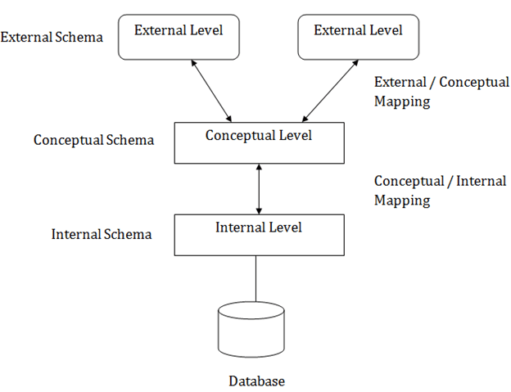

Slide 4
External Level
- Closest to the end-users.
- Represents individual user views.
- Focuses on specific data needed by users.
- Example:
A student sees grades and course details but not financial records.

Slide 5
Conceptual Level
- Represents the entire database structure.
- Independent of physical storage details.
- Defines entities, relationships, and constraints.
- Example:
The logical schema describing students, courses, and assessments.

Slide 6
Internal Level
- Closest to physical storage.
- Handles data storage, access paths, and indexing.
- Optimizes performance and storage space.
- Example:
File storage formats, indexes, and data compression techniques.

Slide 7
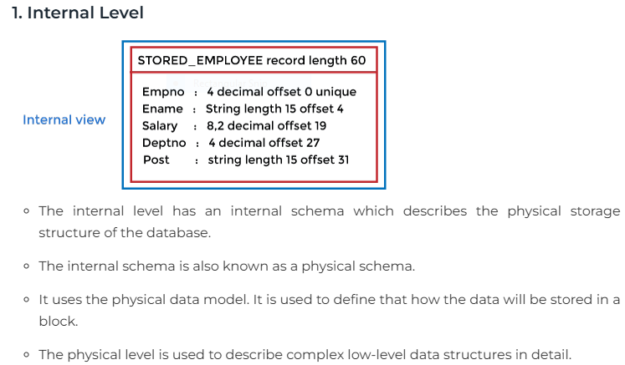

Slide 8
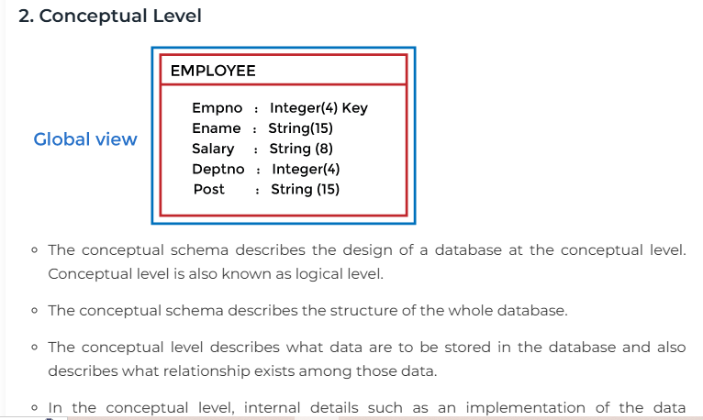
The conceptual level describes what data are to be stored in the database and also describes what relationship exists among those data.
In the conceptual level, internal details such as an implementation of the data structure are hidden.
Programmers and database administrators work at this level.

Slide 9
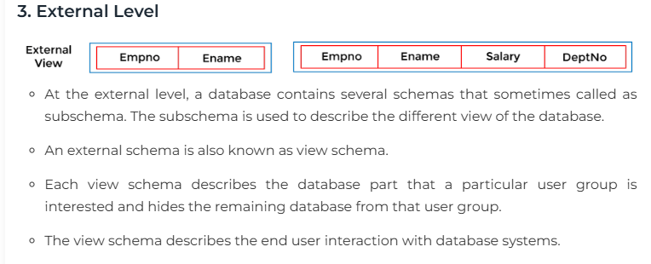

Slide 10
Mapping between Views
The three levels of DBMS architecture don't exist independently of each other. There must be correspondence between the three levels i.e. how they actually correspond with each other. DBMS is responsible for correspondence between the three types of schema. This correspondence is called Mapping.
There are basically two types of mapping in the database architecture:
Conceptual/ Internal Mapping
External / Conceptual Mapping
Conceptual/ Internal Mapping
The Conceptual/ Internal Mapping lies between the conceptual level and the internal level. Its role is to define the correspondence between the records and fields of the conceptual level and files and data structures of the internal level.
External/ Conceptual Mapping
The external/Conceptual Mapping lies between the external level and the Conceptual level. Its role is to define the correspondence between a particular external and the conceptual view.

Slide 11
Data Independence
- **Logical Data Independence**:
- Changes at the conceptual level do not affect the external level.
- **Physical Data Independence**:
- Changes at the internal level do not affect the conceptual level.
- Ensures flexibility and adaptability.

Slide 12
Advantages of 3-Level Architecture
- Promotes data abstraction and independence.
- Simplifies database design and maintenance.
- Provides multiple user views.
- Enhances security by restricting access to specific views.

Slide 13
Parameters | Physical Data Independence | Logical Data Independence
Basics | Physical data independence is concerned mainly with how a set of data/ info gets stored in a given system. | Logical data independence is concerned mainly with the changing definition of the data in a system or its structure as a whole.
Ease of Retrieving | We can easily retrieve it. | Retrieving is very difficult because the data mainly depends on its logical structure and not its physical location.
Ease of Achieving | Achieving physical data independence is much easier as compared to logical data independence. | Achieving logical data independence is more difficult as compared to physical data independence.
Degree of Changes Required | The changes made at the physical level need not be made at the application level. | Any changes made at the physical level need to be made at the application level as well.
Internal Modification | We may or may not need the modifications at the internal level for improving the performance of a system’s structure. | Making modifications at the logical level is a prerequisite whether we want to change the database structure or not.
Type of Schema | The internal schema is the primary concern. | The conceptual schema is the primary concern.
Examples | For example, altering the compression techniques, storage devices changes, and changes in the hashing algorithms. | For example, adding, deleting, or modifying any attribute in a syste

Slide 14
Diagram of 3-Level Database Architecture

Slide 15
Use Case Example
- **Scenario**: University Database
- External Level: Students see grades; faculty sees performance analytics.
- Conceptual Level: Defines entities like students, courses, and grades.
- Internal Level: Manages how data is stored and accessed.

Slide 16
Conclusion
- 3-Level Architecture provides a robust framework for database design.
- Ensures data abstraction, independence, and security.
- Essential for modern database management systems.

Slide 17
Q&A
Questions and Discussion

